Slide 1
Design Patterns

Slide 2
What is Design Patterns ?
Design Patterns are reusable solutions to the problems
Used to solve the problems of Object Generation and Integration

Slide 3
Types of Design Patterns
Gang of Four (GOF) categorized the Design Pattern into three main categories based on the three problem areas (Object Creation and Initialization, Structural Changes of Classes and Interfaces, and the Relationship Between Classes and communication Between Objects) of software architecture. They are as follows
Creational Design Pattern (Object Creation and Initialization)
Structural Design Pattern (Structural Changes of Classes, and Interfaces, and the Relationship Between Classes)
Behavioral Design Pattern (Communication Between Objects)

Slide 4
Creational Design Patterns
Helps us to centralize the object creation and initialization logic
It will create and initialize the appropriate object and return that object to the client
Then, the client can consume the object by calling the necessary methods and properties
The client does not know how the object is created and initialized

Slide 5
Creational Design Patterns
Singleton,
Factory,
Builder,
Prototype,
Abstract Factory

Slide 6
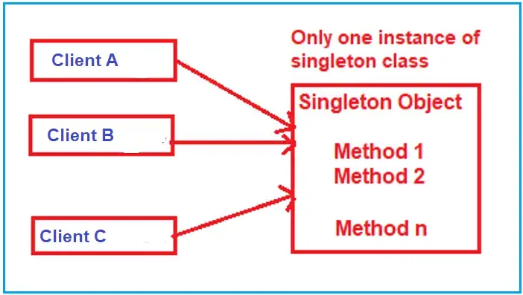
Singleton Pattern
Used to ensure that a class has only one instance and provides a global point of access to it.
When we need exactly one instance of a class to coordinate actions across the system

Slide 7
Key Characteristics of the Singleto
Single Instance
Global Access

Slide 8
Implementation steps of Singleton
Private Parameterless Constructor
Static Variable
Public Static Method or Property

Slide 9
Factory Design Pattern
A factory is an object used to create other objects.
In technical terms, a factory is a class with a method.
That method creates and returns different objects based on the received input parameter

Slide 10
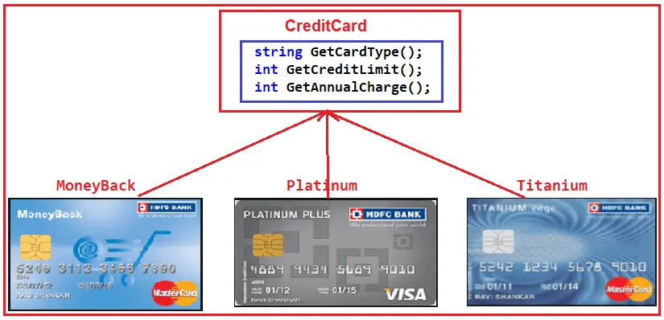
Real-Time Example to Understand Factory Design Pattern

Slide 11
Prototype Design Pattern
Prototype Design Pattern specifies the kind of objects to create using a prototypical instance and creates new objects by copying this prototype
That means it clones the existing object with its data into a new object. If we make any changes to the cloned object (i.e., new object), it does not affect the original object

Slide 12
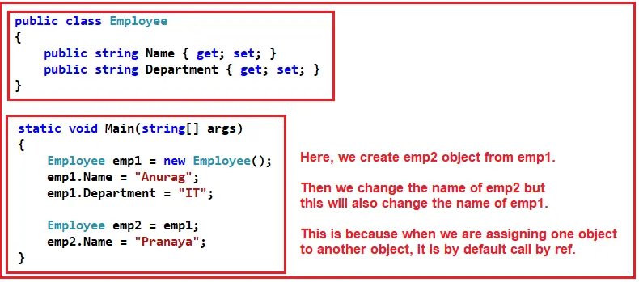
Problem statement

Slide 13
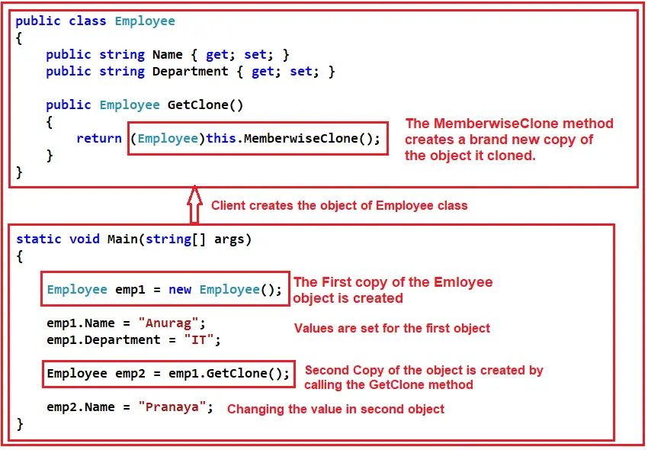
Prototype solution

Slide 14
When to use prototype?
when we want to create a Duplicate or Cloned Object from an Existing object to enhance the application’s performance
when creating an object is time-consuming, costly, and complex
Object Pooling: Real-time systems often use object pools (pre-instantiated objects ready to be reused) to manage resources efficiently, especially in high-load scenarios. The Prototype pattern can facilitate the management of such pools, allowing for the resetting and reusing of objects by cloning a clean prototype instead of recreating objects from scratch

Slide 15
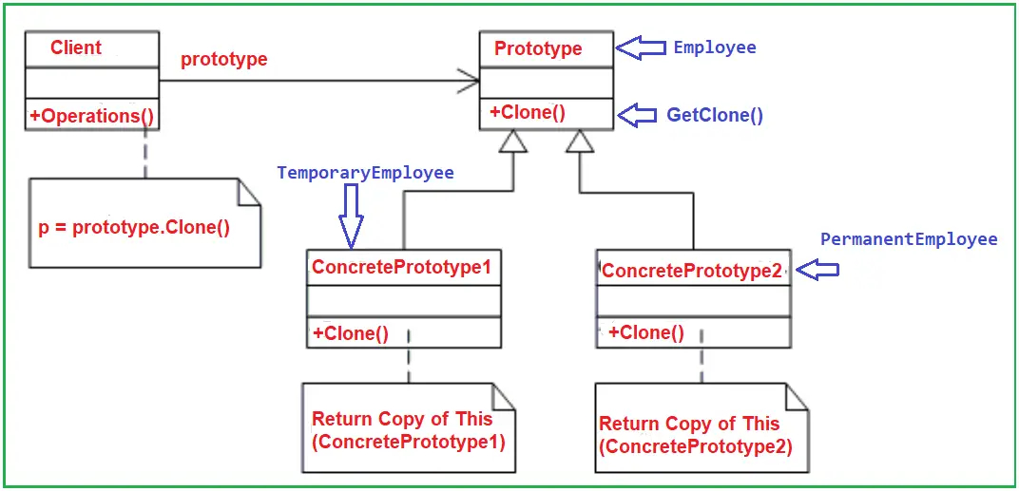

Slide 16
Builder design pattern
Builder Design Pattern builds a complex object using many simple objects and a step-by-step approach
The Process of constructing the complex object should be so generic that the same construction process can be used to create different representations of the same complex object.

Slide 17
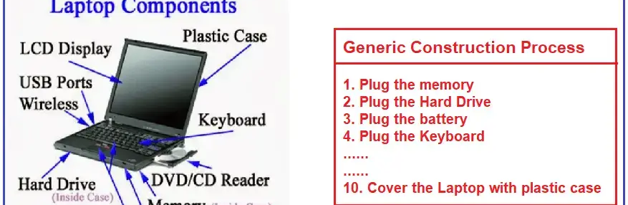
Process

Slide 18
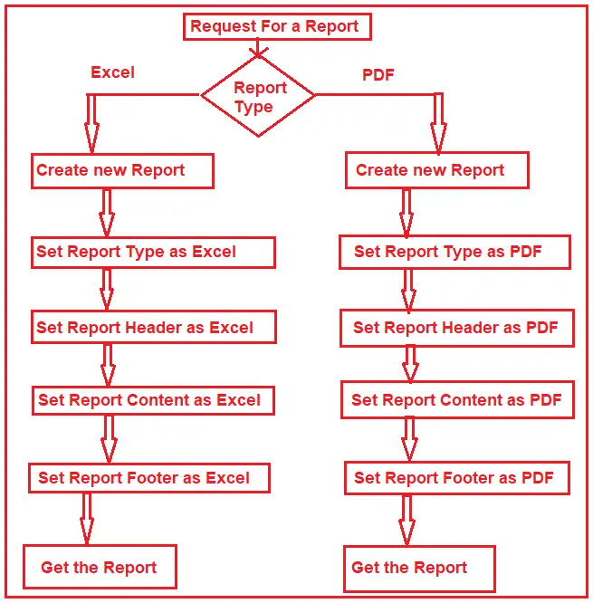
Understand Builder Design Pattern:

Slide 19
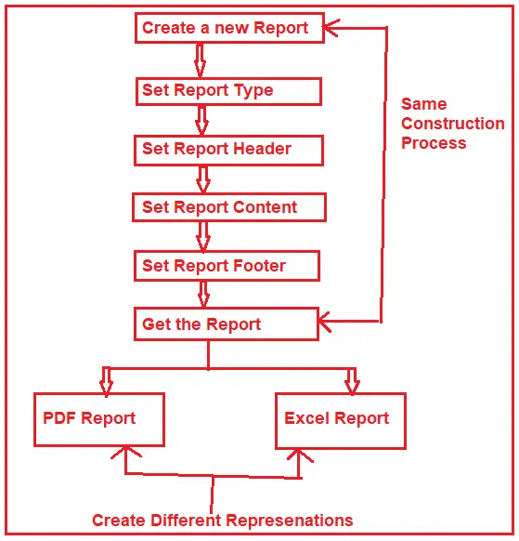
Final builder design output

Slide 20
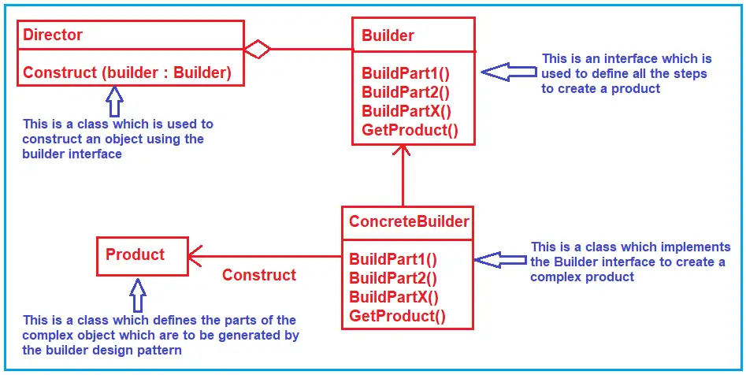
UML – Builder design

Slide 21
Structural Design patterns
The Structural Design Patterns simplify the design by identifying a simple way to manage the relationships between entities
In real-time applications, sometimes we need to change the structure of a class or the relationship among the classes, but we don’t want this change to be affected by the project

Slide 22
List of Structural Design Patterns.
Adapter Pattern
Bridge Pattern
Composite Pattern
Decorator Pattern
Facade Pattern
Flyweight Pattern
Proxy Pattern

Slide 23
What is the Adapter Design Pattern?
It allows objects with incompatible interfaces to work together
It acts as a bridge between two incompatible interfaces.
This pattern is useful when you want to use existing classes, but their interfaces do not match the one you need.

Slide 24
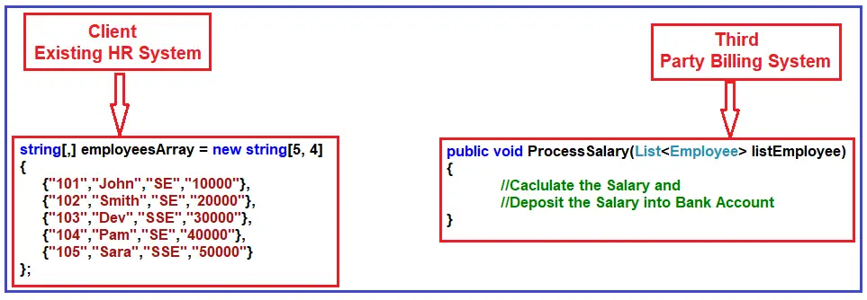
Example – Adapter design

Slide 25
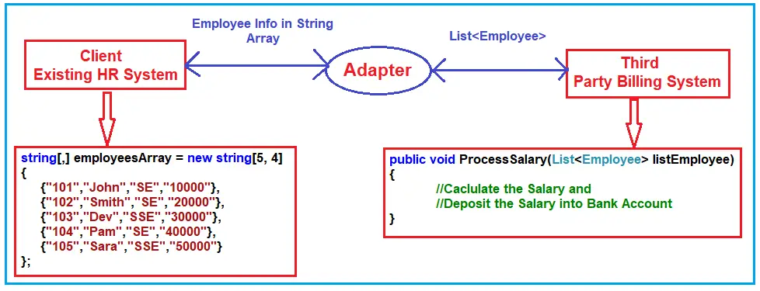

Slide 26
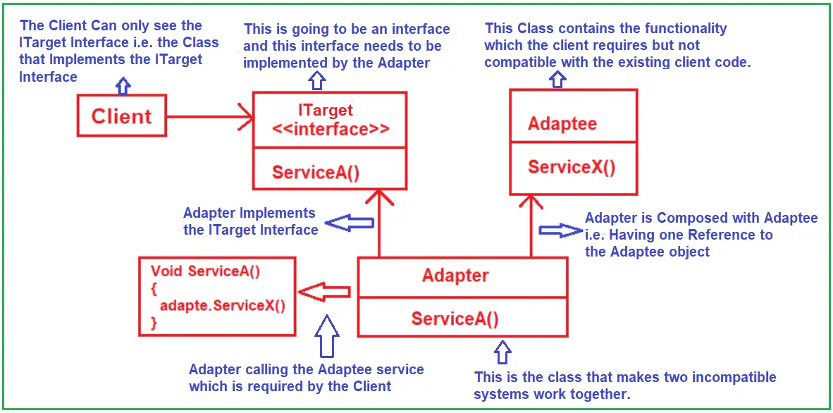
UML - Adapter

Slide 27
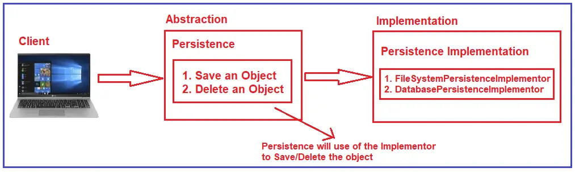
Bridge Design Pattern
Decouples an abstraction from its implementation so that the two can vary independently
This pattern involves an interface that acts as a bridge between the abstraction class and implementer classes

Slide 28
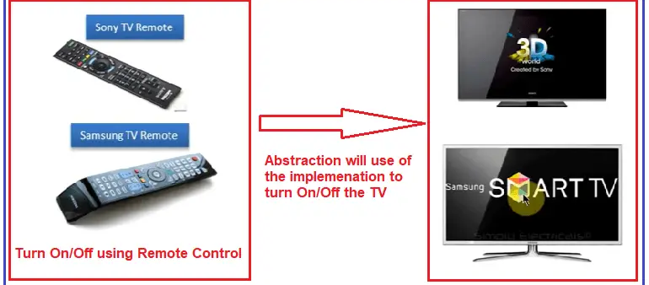
Example – Bridge design pattern

Slide 29
Composite Design Pattern
Compose objects into tree structures to represent part-whole hierarchies. Composite lets clients treat individual objects and compositions of objects uniformly

Slide 30
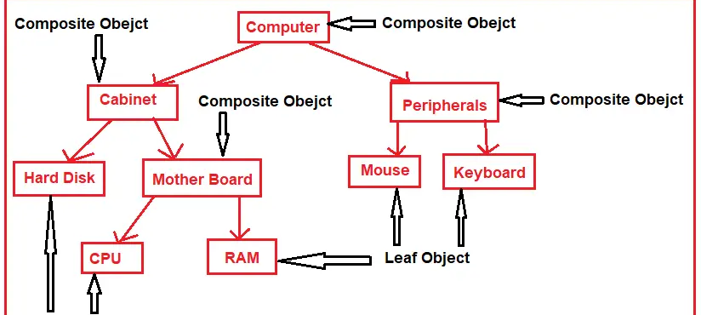
Example

Slide 31
Implementation of Composite Design Pattern
Component Interface: Define an interface or abstract class for implementing the composites and leaf nodes.
Leaf: Implement the component interface for the leaf nodes with no children.
Composite: Implement the component interface and also include a collection of components. The composite object can add, remove, and access the child components.
Client Code: The client works with all elements through the component interface.

Slide 32
Decorator Design Pattern
Allows us to dynamically add new functionalities to an existing object without altering or modifying its structure
This design pattern acts as a wrapper to the existing class
That means the Decorator Design Pattern dynamically changes the functionality of an object at runtime without impacting the existing functionality of the object

Slide 33
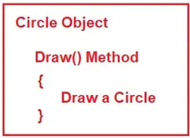
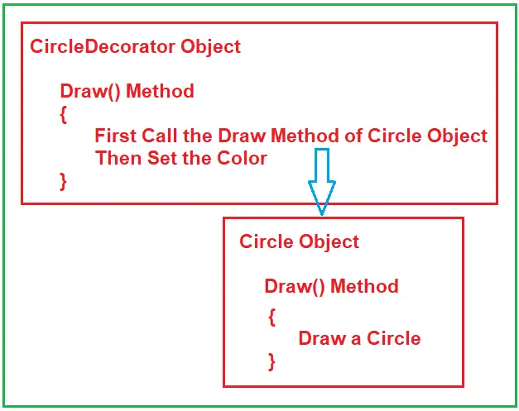
Example

Slide 34
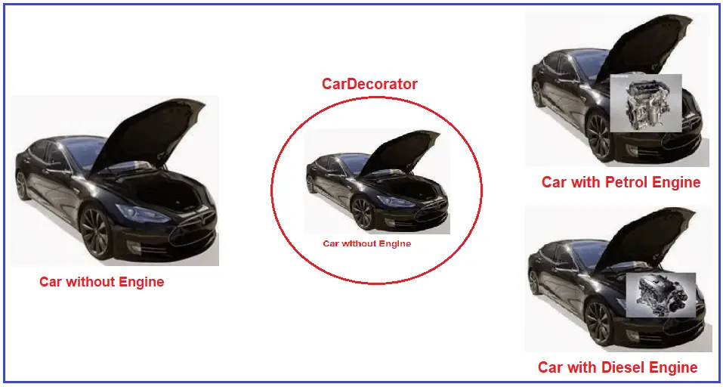
Example

Slide 35
Implementing the Decorator Design Pattern
Step 1: Creating the Car interface
Step 2: Creating Concrete Car
Step 3: Creating a Car Decorator
Step4: Creating Diesel Car Decorator
Step5: Creating Petrol Car Decorator
Step6: Client code

Slide 36
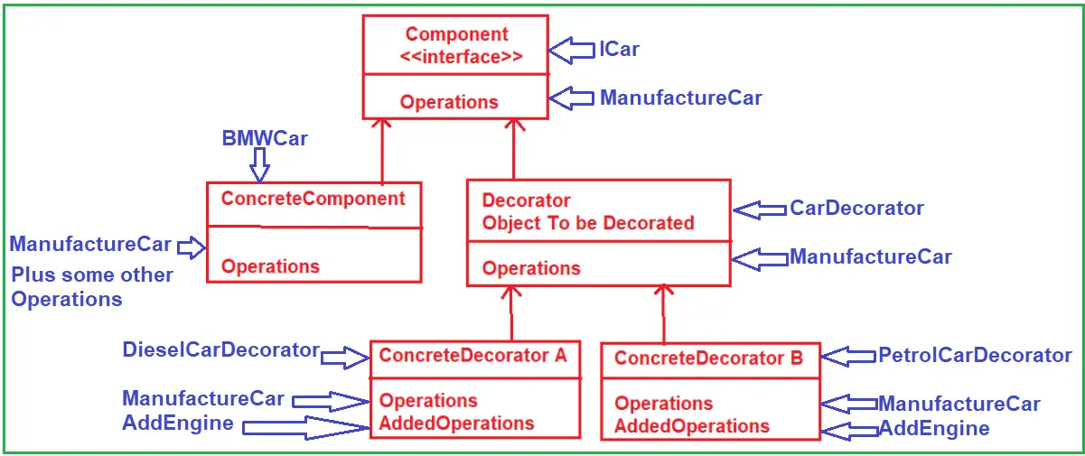
UML – Decorator design

Slide 37
Advantages of Decorator Design Pattern:
Flexibility: Provides a more flexible way to add object responsibilities than static inheritance.
Dynamic Responsibilities: You can add or remove responsibilities from an object at runtime.
Functionality Layering: Allows for the layering of functionalities. Each decorator adds its behavior before and/or after delegating the task to the base component.
Single Responsibility Principle: Promotes smaller, cohesive classes that each handle one responsibility.

Slide 38
Proxy Design Pattern
Proxy Design Pattern provides a surrogate (act on behalf of another) or placeholder for another object to control access to it
The proxy could interface with anything, such as a network connection, a large object in memory, a file, or other resources that are expensive or impossible to duplicate.

Slide 39
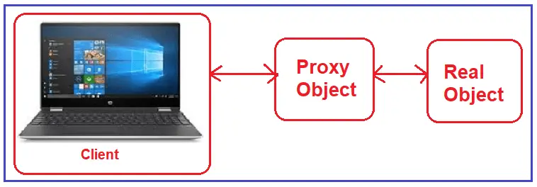
Example

Slide 40
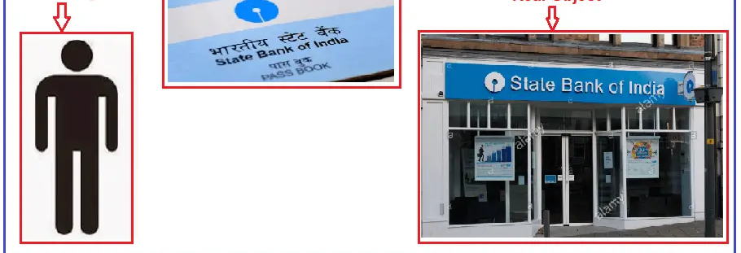
Example

Slide 41
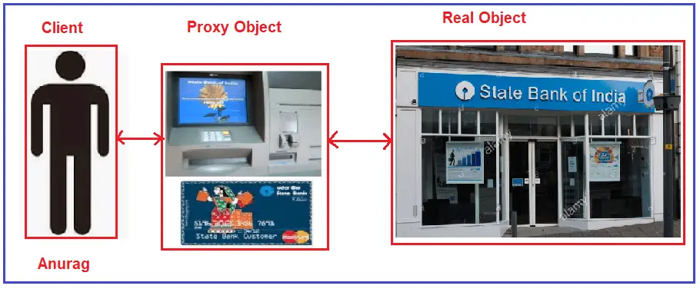
Example

Slide 42
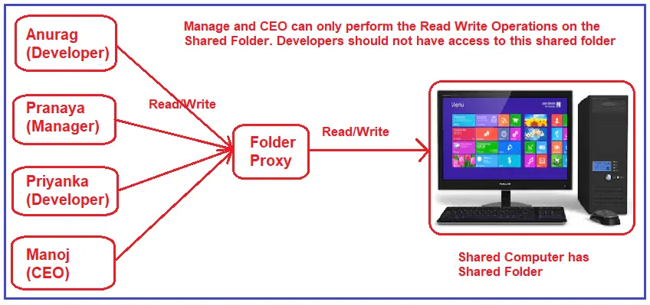
Example

Slide 43
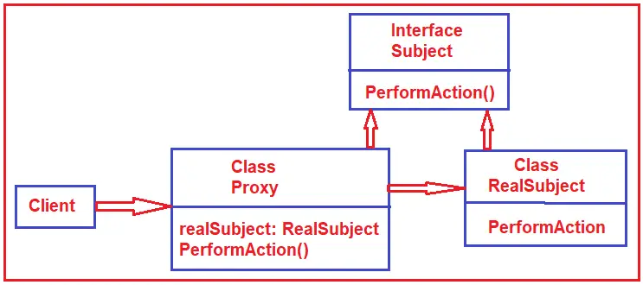
UML - Proxy

Slide 44
Facade Design Pattern
Facade Design Pattern states that you need to provide a unified interface to a set of interfaces in a subsystem. The Facade Design Pattern defines a higher-level interface that makes the subsystem easier to use.

Slide 45
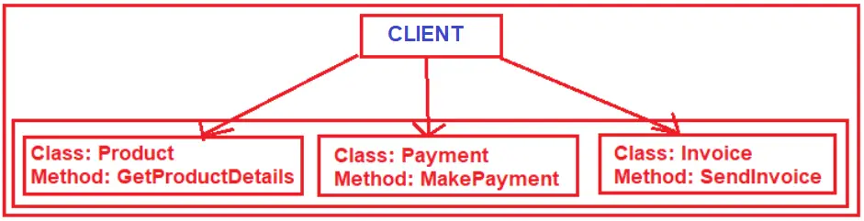

Slide 46
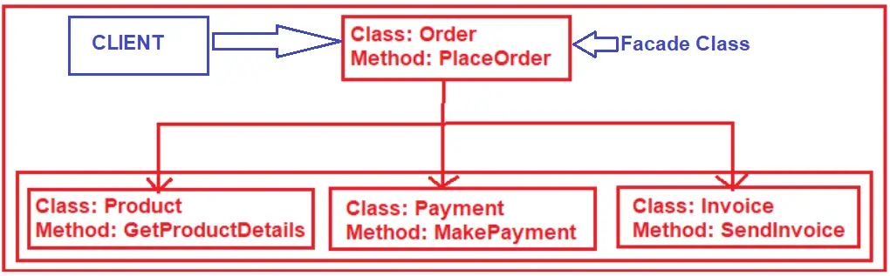

Slide 47
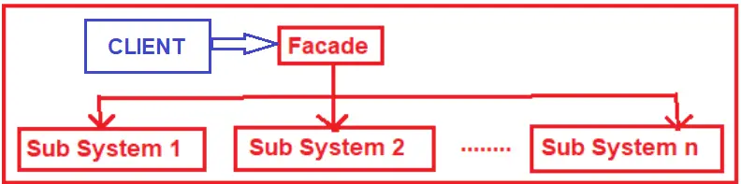
UML - facade

Slide 48
Flyweight Design Pattern
The Flyweight Design Pattern reduces the number of objects created, decreases memory footprint, and increases performance.
It’s especially useful when many objects share some common properties.
That means the Flyweight Design Pattern is used when there is a need to create many objects of almost similar nature. A large number of objects means it consumes a large amount of memory, and the Flyweight Design Pattern provides a solution for reducing the load on memory by sharing objects

Slide 49
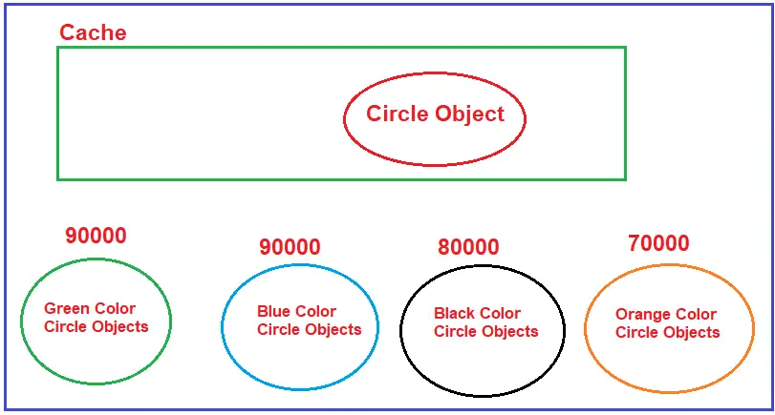
Example to Understand Flyweight Design Pattern

Slide 50
Different States in Flyweight Design Pattern
In Flyweight Design Pattern, there are two states, i.e., Intrinsic and Extrinsic.
Intrinsic states are things that are Constants and Stored in Memory
Extrinsic states are things that are not constant and need to be calculated on the Fly

Slide 51
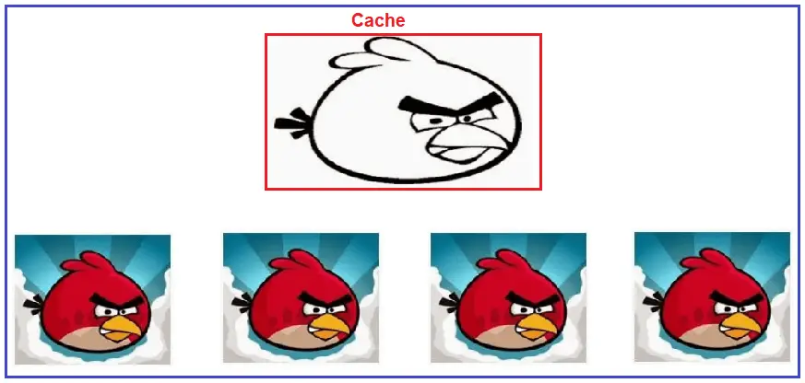
Real-Time Example of Flyweight Design Pattern

Slide 52
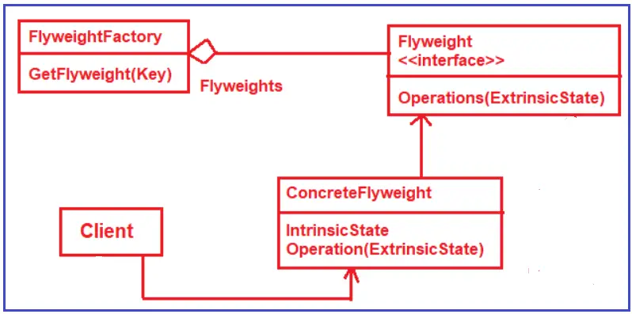
UML - Flyweight

Slide 53
When to use the Flyweight Design Pattern in Real-Time application
Efficient Resource Management: When your application needs to manage a large number of similar objects, keeping an instance of each object is resource-intensive. The Flyweight pattern helps in sharing objects to reduce the memory footprint.
Shared State Objects: In situations where objects can have shared states (intrinsic state) that can be factored out and shared among multiple objects. Flyweight allows for sharing common parts to reduce the system’s memory usage.
High Memory Usage Due to Object Quantity: If your application risks using a large amount of memory due to the sheer volume of objects, the Flyweight pattern can reduce memory consumption by sharing objects instead of creating new ones.
Performance-Critical Applications: In performance-critical applications, the overhead of object creation and garbage collection needs to be minimized, especially in constrained environments such as games or mobile applications.
Immutable Object Requirements: When dealing with immutable objects, their state cannot change after they are constructed. Flyweight makes it easier to manage and share these immutable objects.
Graphical Applications: Commonly used in graphical applications, like graphic editors or games, where many objects (like trees, bullets, or characters) look similar but might differ in some attributes (like position or size).
Text Processing: In text processing applications where you need to represent each character in a document, using a flyweight can significantly reduce memory usage, as each character type can be represented as a single object.
UI Controls: When dealing with user interface elements, similar objects (like buttons, icons, or menu items) are used repeatedly across the application.

Slide 54
Behavioral Design Patterns
The following design patterns belong to the Behavioral Design Pattern category.
Chain of Responsibility Pattern:
Command Pattern:
Interpreter Pattern:
Iterator Pattern:
Mediator Pattern:
Memento Pattern:
Observer Pattern:
State Pattern:
Strategy Pattern:
Template Method Pattern:
Visitor Pattern:

Slide 55

Chain of Responsibility Design Pattern
Avoid coupling the sender of a request to its receiver by giving more than one receiver object a chance to handle the request. Chain the receiving objects and pass the request along until an object handles it

Slide 56
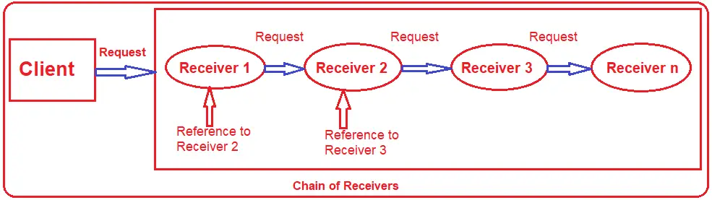
Understanding the Chain of Responsibility Design Pattern

Slide 57
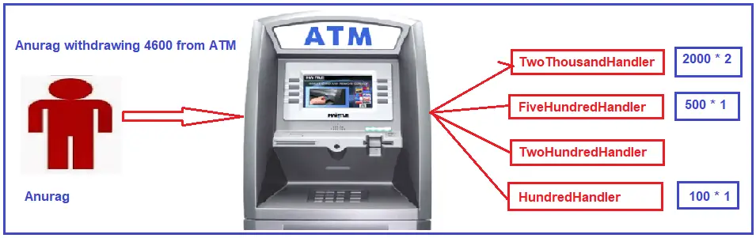
Real-Time Example to Understand Chain of Responsibility Design Pattern

Slide 58
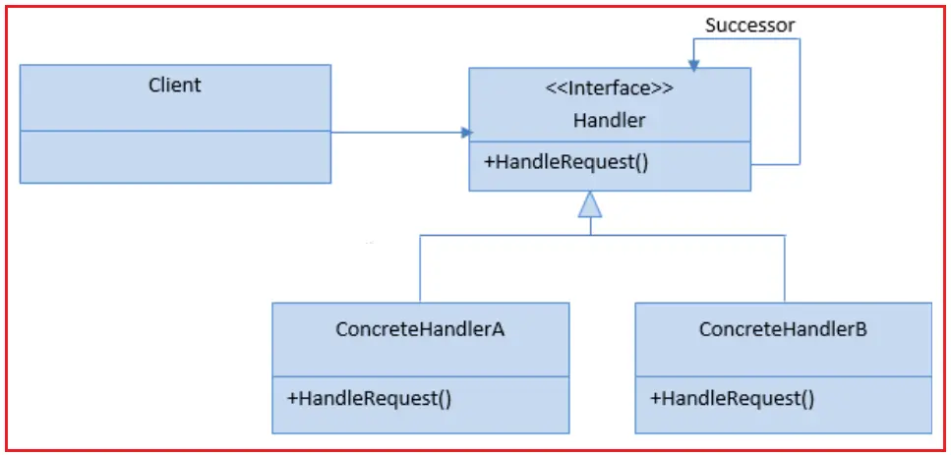
UML

Slide 59
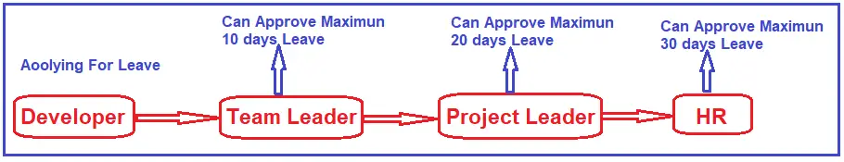
Example

Slide 60
Use Cases of Responsibility Design Pattern
Multiple Handlers for a Request
Decoupling Request Senders and Receivers
Conditional Handling of Requests
Dynamic Handling
Grouping Related Handlers Together
Preventing Direct Coupling
Creating an Audit Trail
Complex Validation or Authorization Processes

Slide 61
Command Design Pattern
Command Design Pattern is used to encapsulate a request as an object (i.e., a command) and pass it to an invoker, wherein the invoker does not know how to serve the request but uses the encapsulated command to perform an action

Slide 62
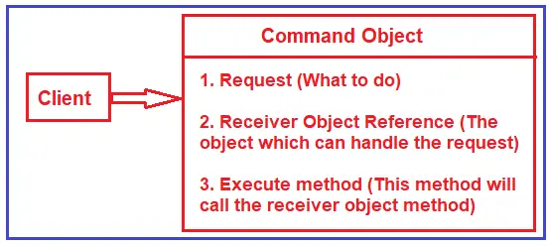
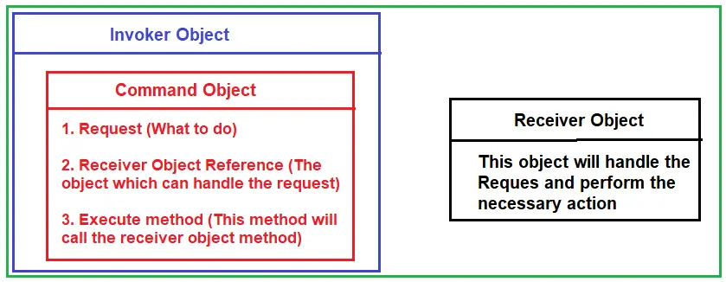
Example

Slide 63
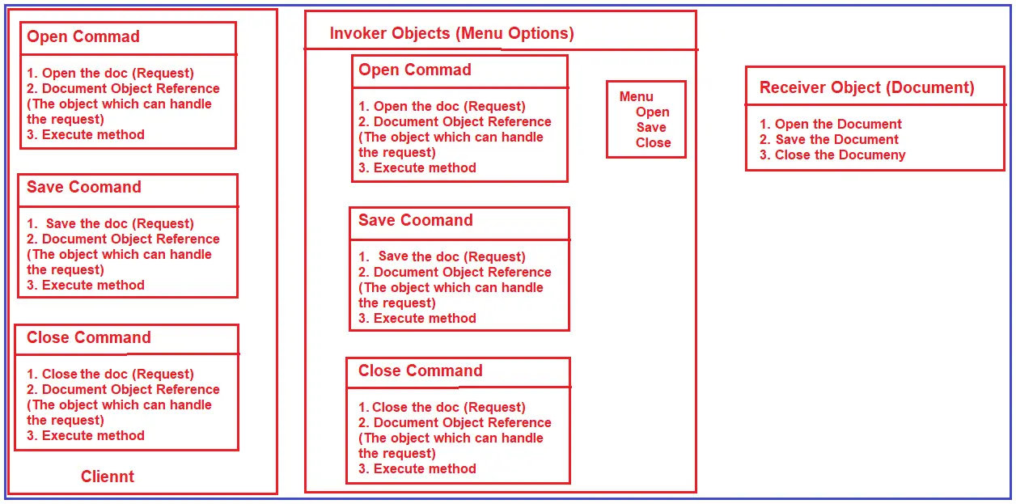

Slide 64
How to Implement Command Design Pattern
Command: This is an interface for executing an operation.
ConcreteCommand: This class extends the Command interface, implementing the Execute method by invoking the corresponding operation(s) on the Receiver object.
Receiver: This class knows how to perform the operations associated with carrying out a request. Any class may serve as a Receiver.
Invoker: This class asks the command to carry out the request.
Client: The client creates a ConcreteCommand object and sets its receiver.

Slide 65
Real-Time Example of Command Design Pattern:
To make you better understand the Command Design Pattern, I have taken the example of a Restaurant. In a Restaurant, the Waiter will be there. What the Waiter will do is, the Waiter will take an order from the Customer. The Customer will tell the Waiter what kind of food he/she wants. The Waiter will note it down on a checklist. Then, the Waiter passes the checklist to the cook. The Cook is the one who will prepare the food and give it back to the Waiter, and the Waiter will give it back to the Customer.
In this example, the Customer is the Client. Order, i.e., what kind of food the customer wants, is the Command. The Waiter is the Invoker

Slide 66
Interpreter Design Pattern
The Interpreter Design Pattern is a Behavioral Design Pattern that defines a grammatical representation of a language and provides an interpreter to deal with this gramma

Slide 67
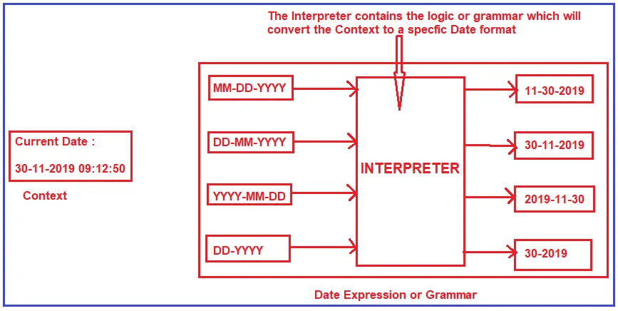
Example – context to format intepreter

Slide 68
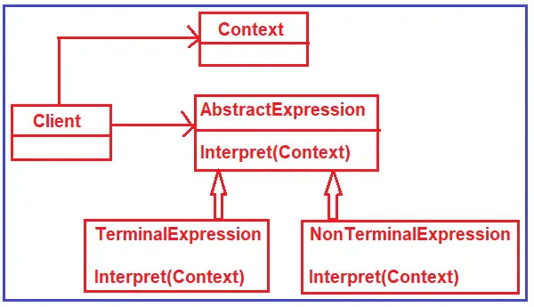
UML

Slide 69
Iterator Design Pattern
It allows sequential access to the elements of an aggregate object (i.e., collection) without exposing its underlying representation
That means using the Iterator Design Pattern, we can access the elements of a collection sequentially without knowing its internal representations
This pattern provides a uniform interface for traversing different data structures.

Slide 70
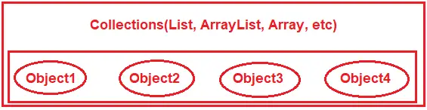
Example
So, the main use of the Iterator Design Pattern is to access the elements (object1, object2, object3, object4, etc.) of a collection (i.e., List, ArrayList, Array, etc.) sequentially.

Slide 71
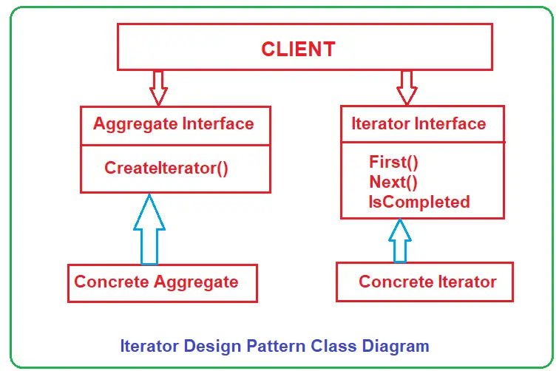
UML - Iterator

Slide 72
When to Use Iterator Design Pattern?
When your collection has a complex data structure, and you want to hide its complexity from the client.
When you want to provide a uniform interface for traversing different data structures.
When you need to have multiple ways of traversing a collection.

Slide 73
Mediator Design Pattern
Define an object that encapsulates how a set of objects interact with each other. Mediator promotes loose coupling by keeping objects from explicitly referring to each other and letting you vary their interaction independently.
The Mediator Design Pattern reduces the communication complexity between multiple objects. This design pattern provides a mediator object, which will be responsible for handling all the communication complexities between different objects

Slide 74
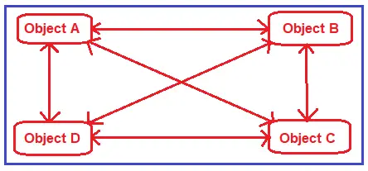
Example to Understand Mediator Design Pattern
The couplings between the objects are more, i.e., tight coupling. A lot of object knows each other. Now, in the image, four objects are there. In real-time, you may have thousands of objects, and those thousands of objects want to communicate with each other. Then, writing code and maintaining code is very difficult.

Slide 75
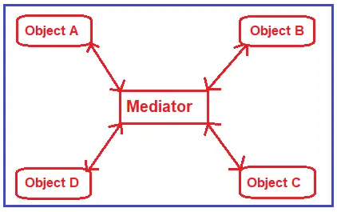
How do we Reduce the Coupling Between the Objects?

Slide 76
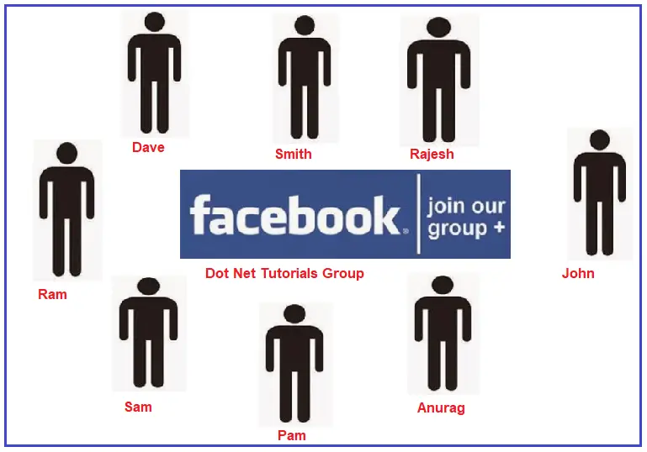
Real-Time Example to Understand Mediator Design Pattern – Facebook Group

Slide 77
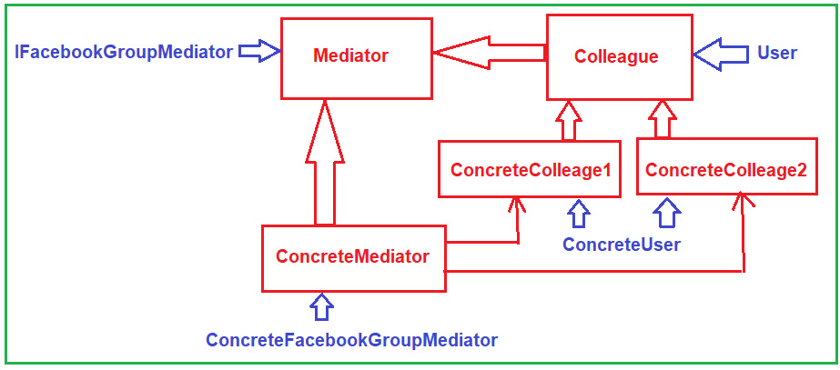
UML - Mediator

Slide 78
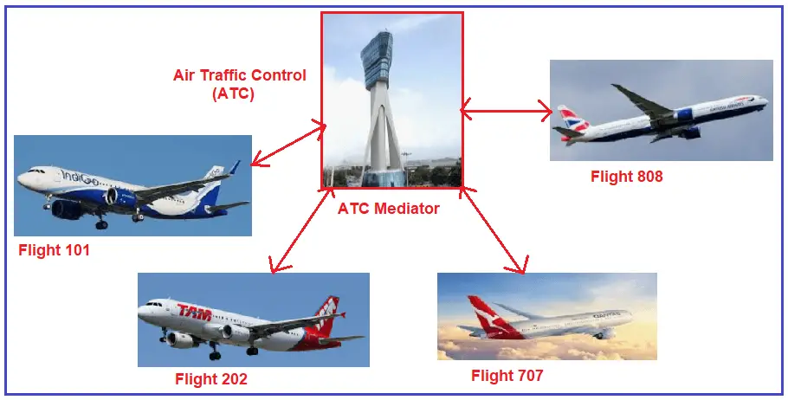
Real-Time Example of Mediator Design Pattern – ATC

Slide 79
Advantages of Mediator Design Pattern:
Reduced Complexity: It centralizes complex communications and controls logic between objects in a system.
Decoupled Objects: Colleague objects are less coupled to each other, which increases maintainability and reusability.
Simplified Object Protocols: Objects no longer communicate directly with each other but instead through a mediator, simplifying their interaction protocols.
Centralized Control: The mediator encapsulates the logic for how objects interact, making it easier to change the logic independently of the colleague classes.

Slide 80
Memento Design Pattern
It is restore an object to its previous state.
It useful for scenarios where you need to perform an undo or rollback operation in your application
The Memento pattern captures an object’s internal state so that the object can be restored to this state later.
It is especially useful when implementing undo functionality in an application.

Slide 81
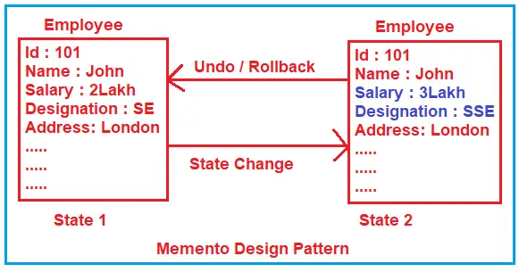
Example to Understand Memento Design Pattern:
After some time, let’s undo or roll back the employee information to its previous state, i.e., State 1. If this is your requirement, you must use the Memento Design Pattern and roll back the employee information to its previous state.

Slide 82
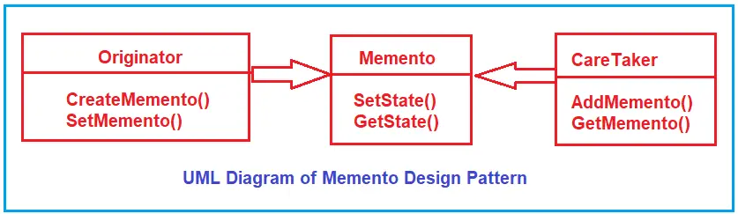
UML - Memento

Slide 83
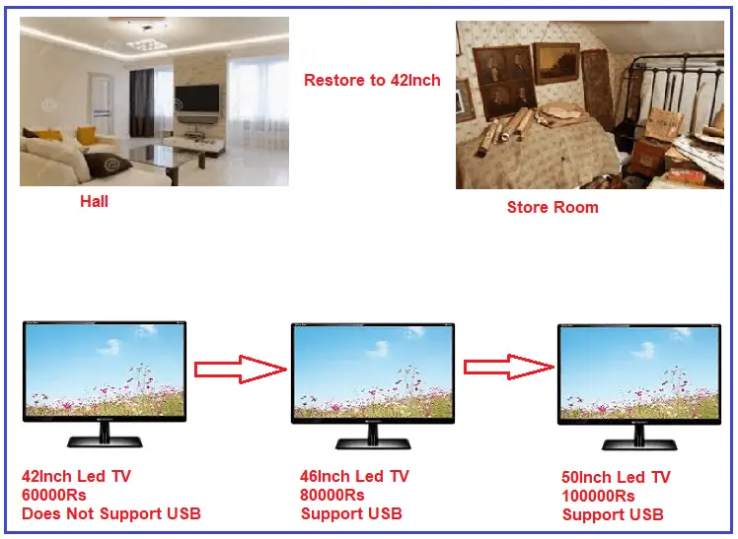
Real-Time Example to Understand Memento Design Pattern
In this example, the Hall is the Originator where we will store the Memento Object, and the Store Room is the Caretaker which is keeping the Memento. Led TV is the Memento, i.e., it is used to hold the internal state of LED TV. This is one of the best examples of the Memento Design Pattern. So, in a scenario like this, we need to use the Memento Design Pattern in our Real-Time Application.

Slide 84
Observer Design Pattern
Defines a one-to-many dependency between objects so that when one object changes state, all its dependents are notified and updated automatically
It used for implementing distributed event-handling systems where an object needs to notify other objects about its state changes without knowing who these objects are
In the Observer Design Pattern, an object (called a Subject) maintains a list of its dependents (called Observers)
It notifies them automatically whenever any state changes by calling one of their methods
The Other names of this pattern are Producer/Consumer and Publish/Subscribe

Slide 85
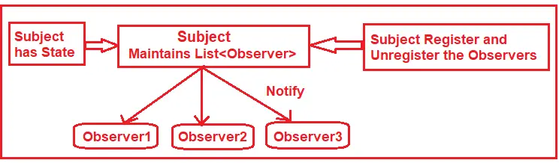
How Does the Observer Design Pattern Work?
Subject: They are also called Publishers. When a change occurs to a subject, it should notify all its Subscribers/Observers.
Observers: They are also called subscribers. They listen to the changes in the subjects.

Slide 86

Real-Time Example to Understand Observer Design Pattern

Slide 87

UML - Observer

Slide 88
State Design Pattern
State Design Pattern allows an object to alter its behavior when its internal state changes.

Slide 89


Example to Understand State Design Pattern

Slide 90

Understanding State Design Pattern With Real-Time Example:

Slide 91

UML – State Design

Slide 92

State Design Pattern Real-Time Example: Vending Machine

Slide 93
Strategy Design Pattern
Define a family of algorithms, encapsulate each one, and make them interchangeable. Strategy lets the algorithm vary independently from clients that use it.

Slide 94

Example to Understand Strategy Design Pattern
As per the Strategy Design Pattern, the client will decide which solution should be used only at runtime. So, the client will decide whether to use Solution 1 to achieve the task, Solution 2 to achieve the task, or Solution 3 to achieve the task only at run time

Slide 95

Understanding the Strategy Design Pattern with Real-time Example:

Slide 96

UML - strategy

Slide 97
Template Method Design Pattern
A Template Method Design Pattern defines a sequence of steps of an algorithm and allows the subclasses to override the steps but is not allowed to change the sequence.

Slide 98


Example to Understand Template Method Design Pattern

Slide 99


Slide 100

UML – Template Design

Slide 101
Visitor Design Pattern
Visitor object that changes an element object’s executing algorithm
When the visitor varies, the execution algorithm of the element object can also vary
As per the Visitor Design Pattern, the element object has to accept the visitor object so that the visitor object handles the operation on the element object.
The Visitor Design Pattern should be used when you have distinct and unrelated operations to perform across a structure of objects (element objects).

Slide 102

Example to Understand Visitor Design Pattern

Slide 103


Real-Time Example to Understand Visitor Design Pattern
So, here in this example, the doctor is nothing but a visitor, and the object structure is the collection of Kids where each kid is an element object
Here, the salesman is the visitor, and the object structure is the same collection of kids, where each kid is an element.

Slide 104
Use Cases of Visitor Design Pattern
When you need to perform operations on a set of objects with different classes and you want to avoid type checks.
When new operations need to be added to complex class hierarchies without changing the classes themselves.

Slide 105

UML - Visitor

